Slide 1

Undergraduate Project
2023-24 II
Prof. Tushar Sandhan
Mentor - Shraddha Tripathi
Porav Rohilla (210727)
Umang Sinha (211124)

Slide 2
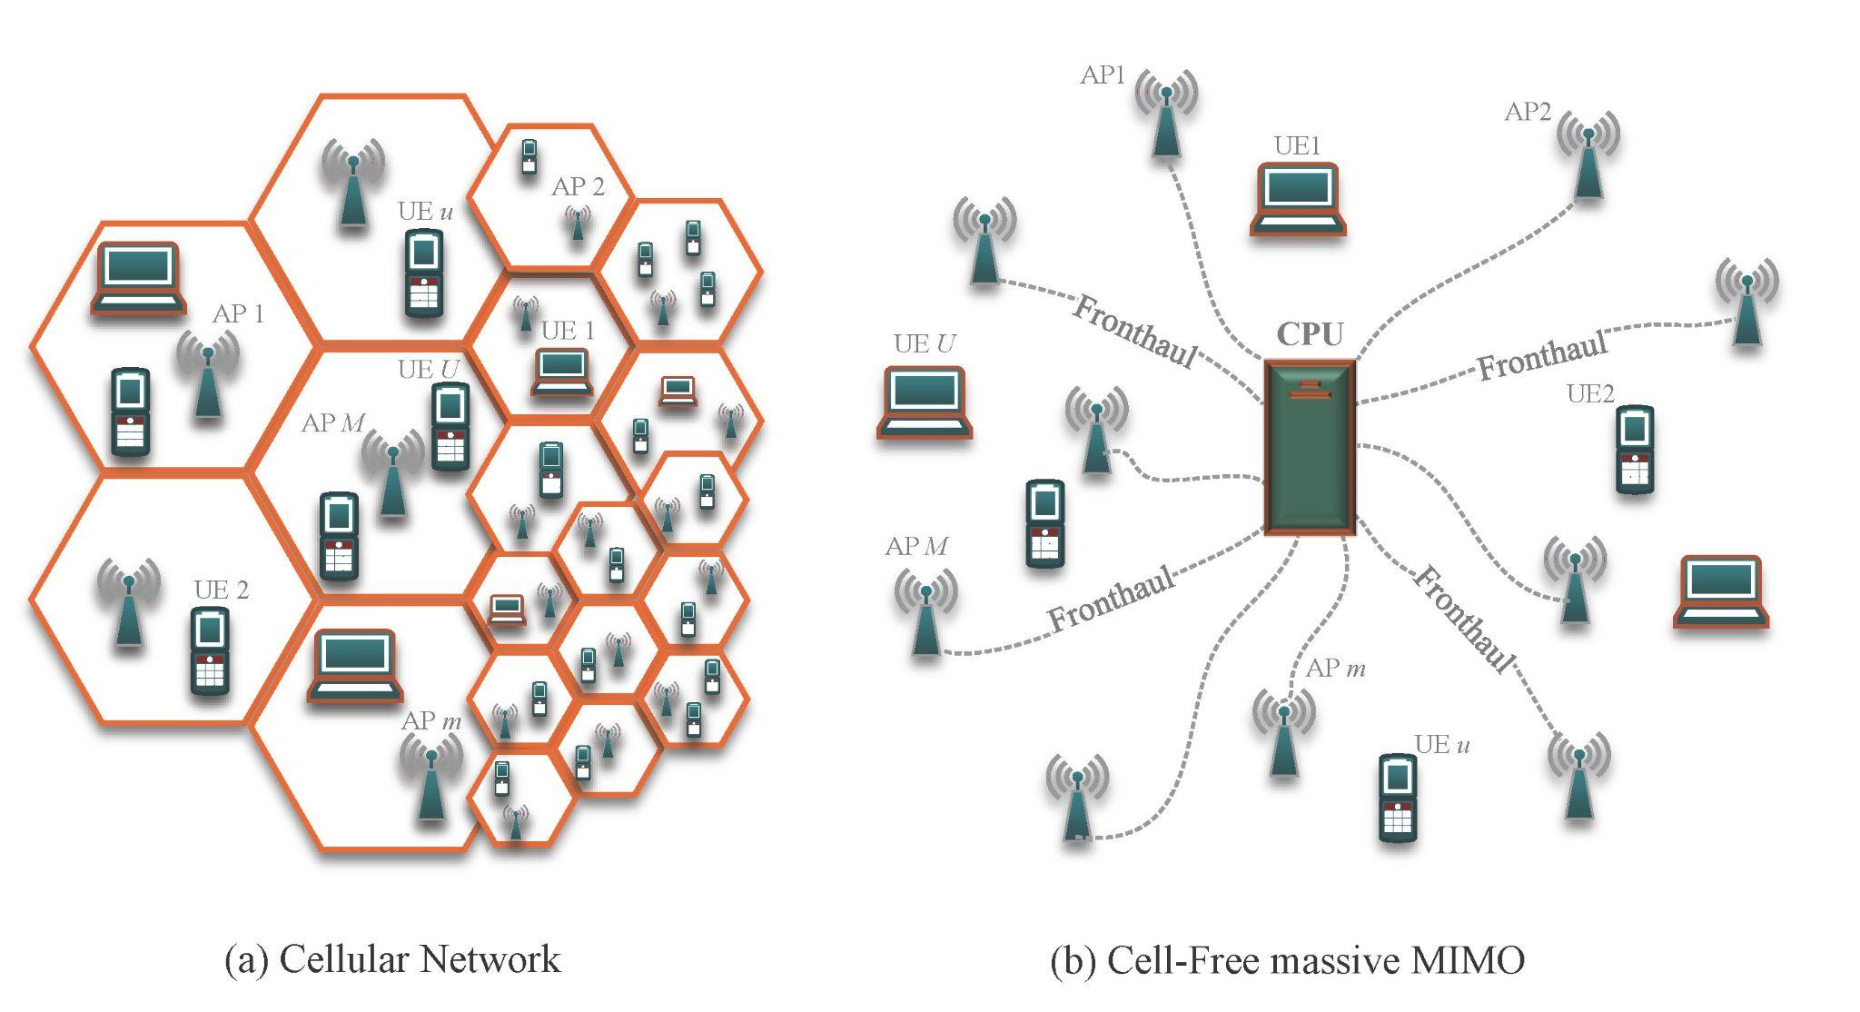
Topic 1 : GNN-Based Pilot Assignment in Cell-Free MIMO
1.0 Problem Statement
What is Cell-Free MIMO?
Conventional mobile networks divide land areas into cells, each served by a single base station.
Limitations arise due to high interference at cell boundaries.
Cell-free structures offer decentralized technology to handle massive connections effectively.

Slide 3
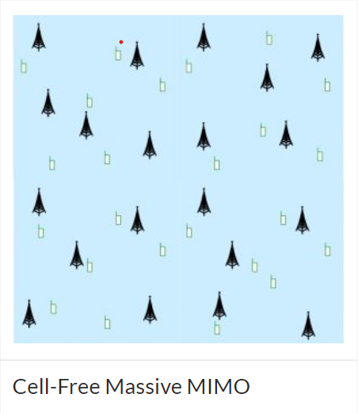
Pilot Assignment in cell-free MIMO
- Pilot assignment involves allocating pilot signals to users across distributed access points without the traditional concept of cell boundaries.
- We will be using Graph Neural Networks (GNNs) for pilot assignment in cell-free Massive MIMO.
- While assigning pilots, 2 constraints to be followed -
no two adjacent users have the same pilot (or label)
minimum no. of unique pilots are used for assignment.
Tasks
Representing the network as a graph
Node features selection
Designing the Graph coloring algorithm

Slide 4
1.1 Related Work
Recently, cell-free massive multiple-input multiple-output (MIMO) has attracted considerable attention due to its ability to avoid the inter-cell interference in cellular MIMO networks.
Various methods have been used for this purpose -
random pilot assignment
greedy pilot assignment
location based greedy (LBG) pilot assignment
graph coloring using AP selection matrix
These various approaches have been discussed in Heng Liu, Jiayi Zhang, Shi Jin and Bo Ai, “Graph Coloring Based Pilot Assignment for Cell-Free Massive MIMO Systems“ .

Slide 5
1.2 Our Proposed Approach
Graph Coloring - implementing basic graph coloring algorithm on a graph consisting of only user nodes. - implementing graph coloring algorithm using AP selection matrix, which uses access point information.
The graph coloring algorithm was implemented because it assigns colors to the nodes in a graph, which is similar to our task of pilot assignment in user nodes, with constraints to be followed are- - no two adjacent users have the same pilot (or label) - minimum no. of unique pilots are used for assignment.
Various modifications were tried and implemented as the work progressed…

Slide 6
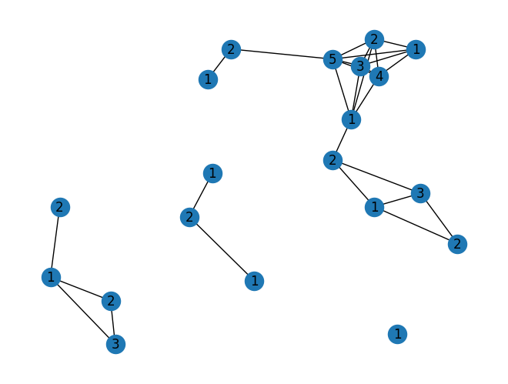
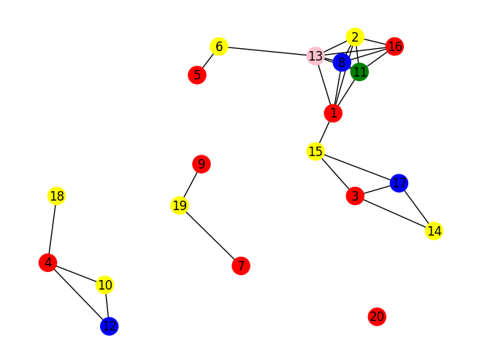
1.3 Dataset
Initially created a homogenous graph based on Euclidean distance criteria.
The graph comprised nodes, which can be considered as users.
The nodes were connected via edges based on a euclidean distance threshold.
Currently, the node features are its color and its position.
However, we’ll explore various other features for node classification using GNN.

Slide 7
1.4 Different Graphs Generated
Started with a basic graph, consisting of user nodes, edges between them based on Euclidean distance criteria.
Modified the graph by introducing access points, added edge between two users if they had more than a particular no. of closest access points in common, in addition to the original edges.
Used the access point selection matrix given in the paper Vismika Ranasinghe, Nandana Rajatheva, and Matti Latva-aho, “Graph Neural Network Based Access Point Selection for Cell-Free Massive MIMO Systems” and added edges between users if they had more than 2 common access points. Applied graph coloring algorithm on this.

Slide 8
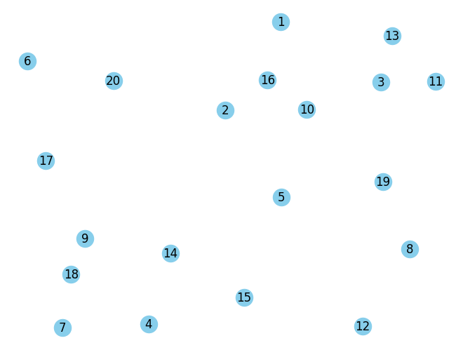
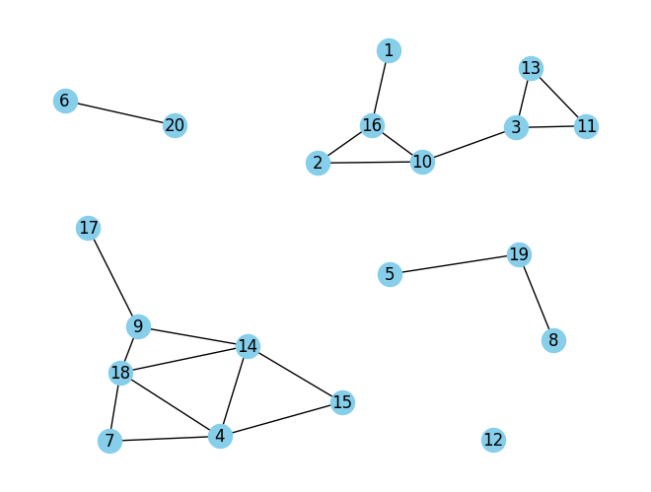
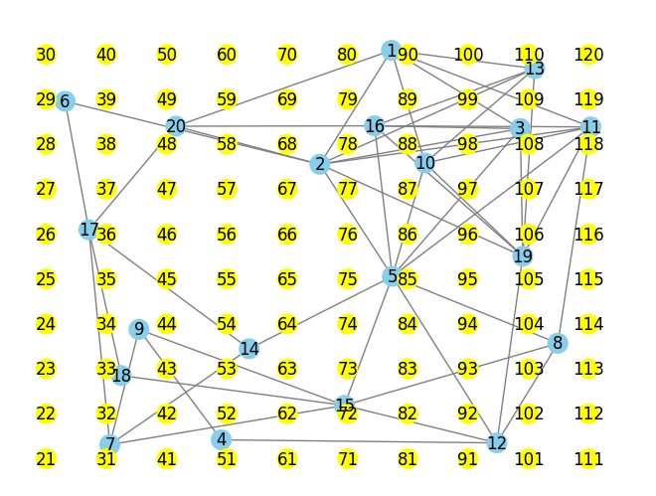
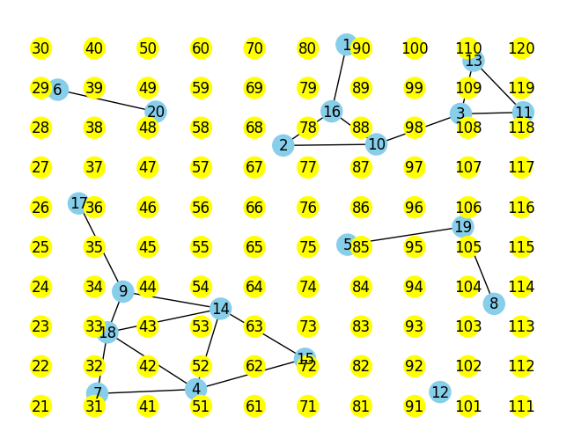
Adding edges based on euclidean dist.
Graph with only user nodes
Edges based on AP_selection_matrix
Graph with randomly located user nodes and uniformly located access points

Slide 9
1.5 Problems faced in Graph Coloring
Standard Graph coloring cannot be used in cell-free massive MIMO systems directly because -
Due to large number of users, the orthogonality among the pilot sequences for all UEs is typically not achieved in cell-free massive MIMO systems.
Also, it does not ensure uniform distribution of pilots, such that some pilots may be used much more than the others, which is not desired as it is not optimal.

Slide 10
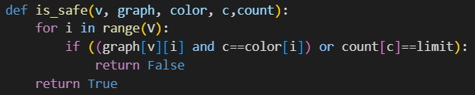
1.6 Modifications
Improved the Graph coloring algorithm by introducing an upper bound on the number of times a particular color is used, and to keep uniform frequency among all colors. This ensured that a particular pilot is not overloaded, and all the available pilots are used almost equally.
Here, the variable ‘limit’ is used to achieve the above constraint, and its value was adjusted accordingly based on the graph parameters.

Slide 11
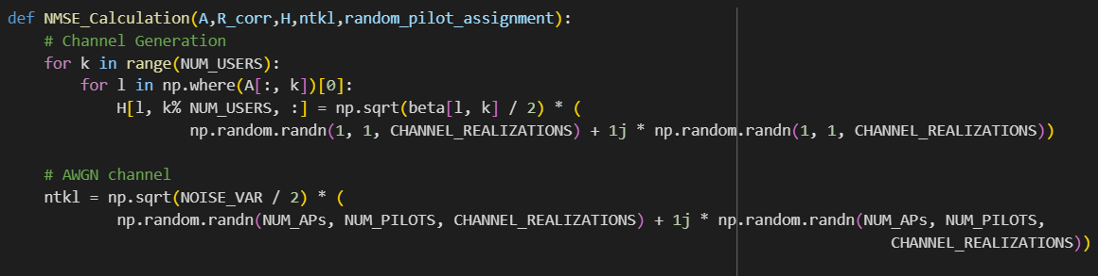
1.7 NMSE Comparison
Used the MATLAB code for NMSE calculation from the previously mentioned paper.
Compared the NMSE values for the basic graph coloring algorithm, and the modified graph coloring algorithm using the AP selection matrix.
Also compared NMSE values for the relaxed graph color algorithm with the existing methods.

Slide 12
1.8 Comparison results
The NMSE values were averaged over 5 iterations , so that the randomness of the graph does not affect the results.
The NMSE value for the modified graph coloring was observed to be less than the basic graph coloring (without AP_selection_matrix)
 | Average NMSE
Basic Graph Coloring | 0.3310
Graph Coloring with AP_selection_matrix | 0.2734

Slide 13
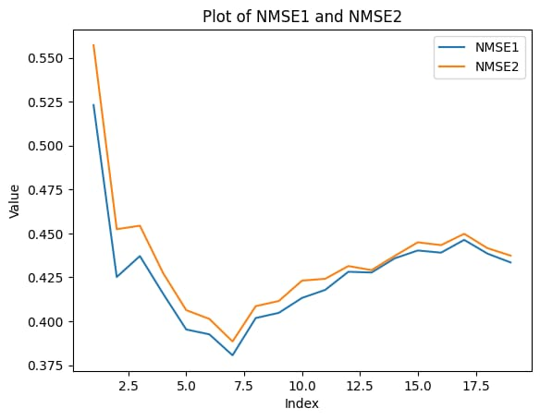
1.9 Initial Graphs…
NMSE1 : For basic graph coloring(without access points)
NMSE2 : For graph coloring with access points
The graph coloring algorithm did not generate solution in every case, due to reasons already discussed.
Due to which, graph was plotted only for ~18 iterations ( originally run for 100 iterations)

Slide 14
1.10 Looking for another modification…
Due to the graph coloring algorithm, there were cases when solution did not exist because the graph was too dense to be colored with a certain number of colors.
However, in the real world scenario for pilot assignment, a solution has to exist in every case whether the network is dense or sparse.
Because, in the actual pilot assignment, there is a possibility of a case where adjacent nodes (users which are closely located) can be assigned same pilots.
This was done by implementing node relaxation.

Slide 15
1.11 Node Relaxation
We implemented node relaxation on certain nodes so that there always exists a solution for assignment of pilots to the users.
Identifying Nodes for Relaxation : Found out the nodes which were violating the usual coloring constraint, based on node features like its degree, node importance, etc.
Coloring Algorithm Modification : modifying the color assignment logic to allow relaxed nodes to have the color that is used minimum times to keep optimality, violating the usual constraint.

Slide 16
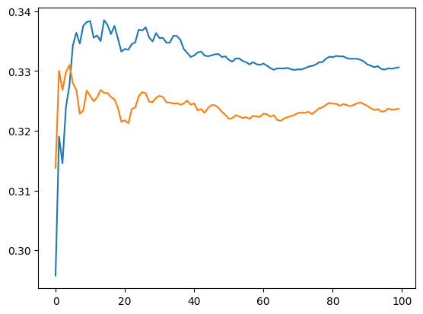
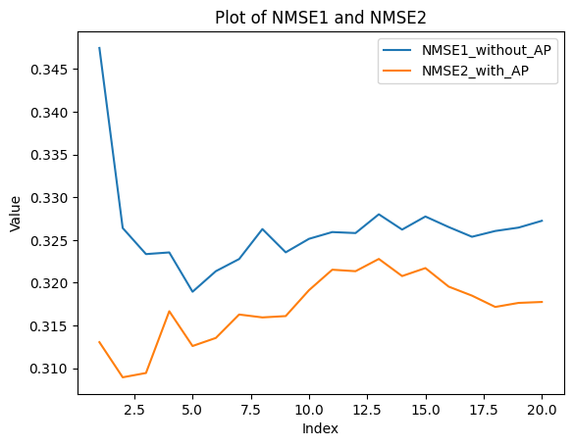
1.12 Results for node relaxation…
NMSE_values without node relaxation
NMSE_values with node relaxation

Slide 17
1.13 Inferences from plots
The average NMSE values obtained from incorporating node relaxation were less than that without node relaxation.
The NMSE values for the modified algorithm which also used the access point information using the AP Selection matrix generated from MATLAB was found to be less than that of the basic graph coloring algorithm ( consisting of only user nodes).
Various other criterias can also be used for implementing node relaxation, like node importance. The one we currently used was node degree.
These could be other ways to be explored to try and further reduce the NMSE of the channel estimation.

Slide 18
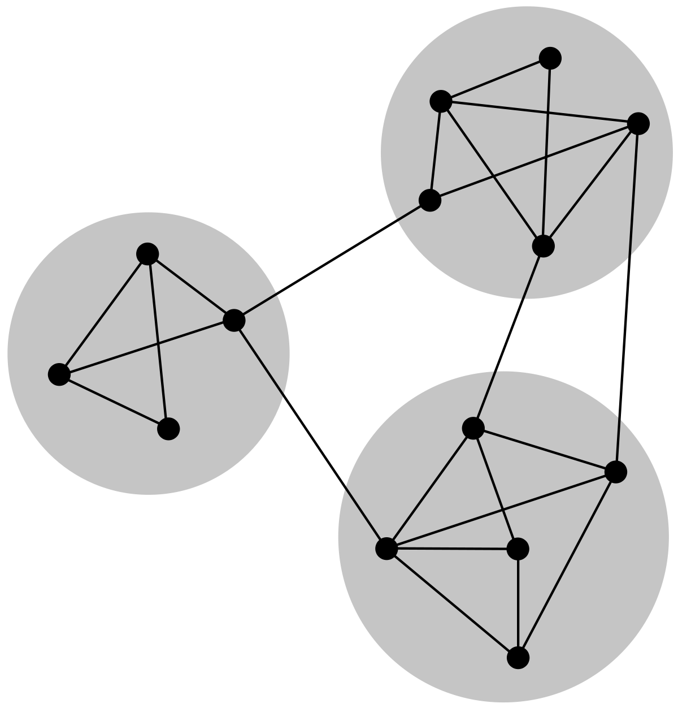
Topic 2 : GNN-Based Node Localization for Indoor Environments
2.0 Problem Statement
What is Indoor Node Localization - Process of determining location within indoor environments.
Challenges with GPS - Blocked signals due to obstacles like walls and ceilings. Difficulty in receiving signals from four satellites for accurate positioning.
Alternative Technologies - WiFi-based localization using signal strength and triangulation. Bluetooth Low Energy (BLE) beacons and Ultra-wideband (UWB) technology. Inertial navigation systems (INS) with accelerometers and gyroscopes.
Application - Asset tracking, navigation assistance, location-based services, indoor mapping.

Slide 19
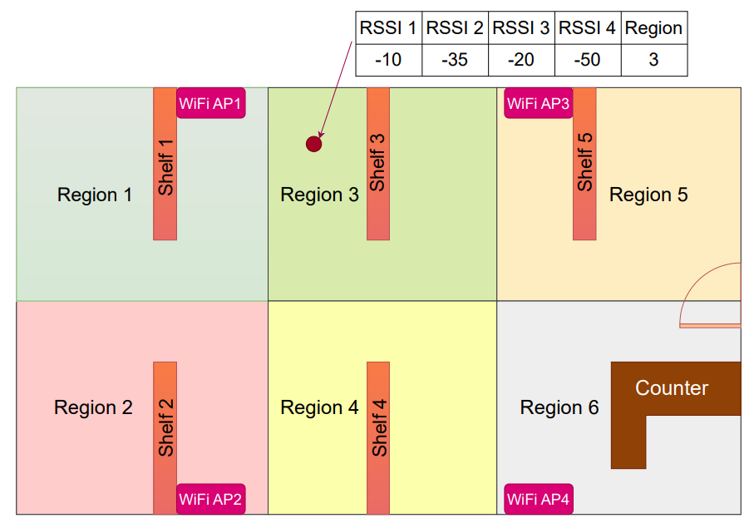
To tackle the problem of indoor localization, various technologies like Bluetooth, RFID, Ultra-wideband and WiFi are explored.
Out of these technologies, WiFi RSSI-based indoor localization is preferred because WiFi access points are generally available in most buildings, and smartphone has WiFi modules that can be used as a receiver, so it does not require any additional infrastructure or hardware to be installed.
RSSI( Received Signal Strength Indicator) is used to estimate the distance between a receiver and a transmitter. The basic idea is that the strength of the received signal decreases as the distance between the transmitter and receiver increases.
Tasks
Representing the network as a graph
Node features selection
Making the GNN architecture
RSSI gauges wireless signal strength, emphasizing variations in distance, affected by obstacles, interference, power, and environmental factors influencing radio waves.

Slide 20
Related Work…
Electromagnetic signal propagation follows the inverse square law but is obstructed by obstacles in indoor environments, challenging signal strength modeling.
Machine Learning (ML) algorithms, including K-Nearest Neighbors (KNN), Decision Trees, Support Vector Machines (SVMs), and Artificial Neural Networks (ANNs), have been utilized for indoor positioning, with kNN, SVM, and Neural Networks showing superior performance.
However, traditional ML models neglect geometric characteristics of indoor localization.

Slide 21
Graph Neural Network (GNN) Approach
GNN-based models have emerged as a promising solution for indoor localization.
Some researchers have proposed a novel approach using heterogeneous graphs based on RSSI between Access Points (APs) and waypoints to represent topological data structure.
Another study addressed limitations of traditional ML algorithms in encoding fingerprint data, proposing a GraphSAGE estimator for localization.
A study introduced a GNN-based model leveraging AP geometry for WiFi RSSI-based indoor localization,
In a separate study authors considered APs as nodes and determined edges based on received power, experimenting with both homogeneous and heterogeneous graphs.

Slide 22
Challenges and Proposed Solution
Indoor localization faces challenges due to signal strength fluctuations in WiFi RSSI data.
Varying signal strengths hinder accurate user/object localization.
To address this, we introduce a graph-based method emphasizing stability of proximity patterns in RSSI data over individual AP RSSI values.
Our method enhances accuracy and reliability of indoor localization, offering a robust solution to fluctuating signal strengths in indoor environments.

Slide 23
Approach to the Problem…
The first step towards the problem was to preprocess the dataset and taking care of those cases where the node is far away from a certain AP.
Using classical Machine Learning methods to see their performance ( baseline ).
Modifying the dataset using Feature Engineering methods to further bolster the performances.
Comparing the new results vs baseline.
Incorporating the Graphical structure of the scenario and using Graph Neural Networks for further improvements.

Slide 24
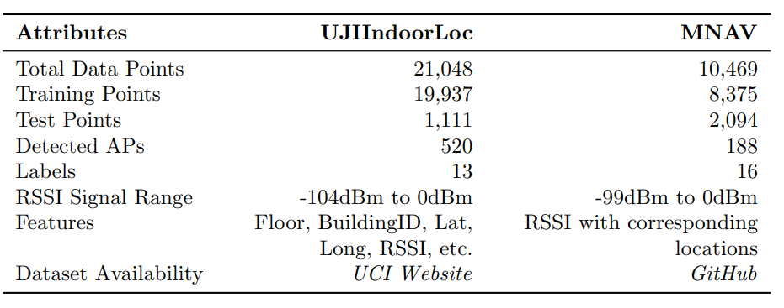
Dataset

Slide 25
Dataset
The UJIIndoorLoc Dataset has 529 features of which 520 are RSSI values from 520 different APs distributed across 3 buildings and 4 or more floors in each.
We implemented a research paper in which Indoor Localization is done using RSSI values as features and building and floor number as the targeted class.
We trained ML models like KNN( k Nearest Neighbours), SVM( Support Vector Machine), MLP Classifier( Multi Layer Perceptron) over the same and got satisfying accuracies above 90% for all the methods.

Slide 26
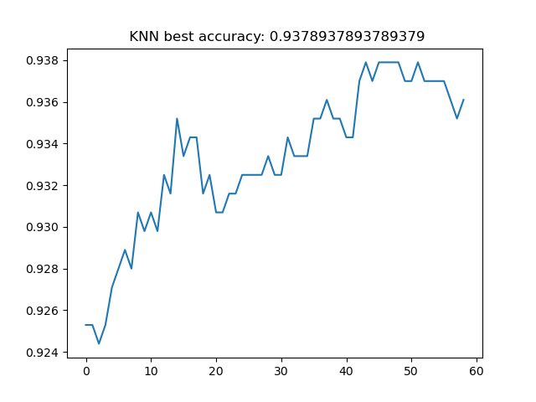
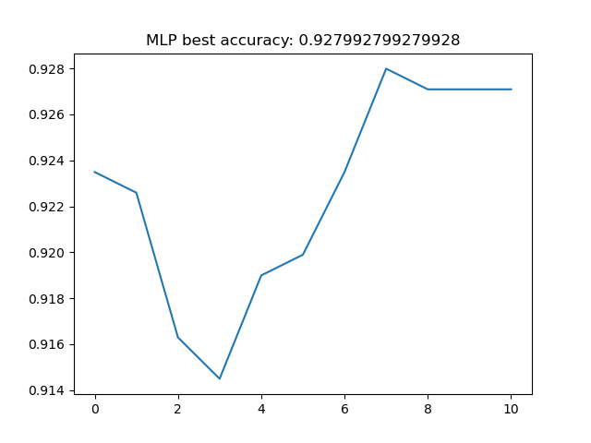
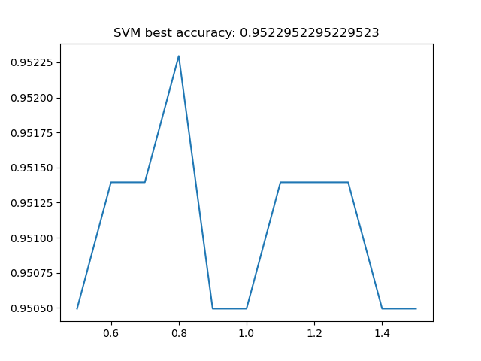

Slide 27
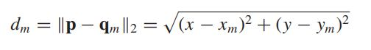
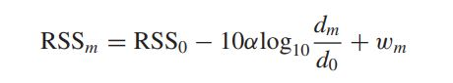
The DRSS factor !
We used RSSI as the measure of the distance of the receiving node from the Access points, but the below expression shows that along with the relative distance of the receiver from the access point, it also depends upon some conditions of the device and external environment.
This could be a possible reason for the hampered accuracies.

Slide 28
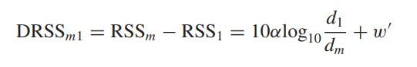
The DRSS factor !
To further fine tune the features so as to get more precise relative distance measurements we introduced a new feature DRSS into the scenario.
DRSS stands for Differential Received Signal Strength and compared to RSSI gives more concrete measurements of the relative distance of the receiving nodes from the Access points.
To eliminate the unknown RSS0, the DRSS observation between the mth receiver and the reference receiver can be expressed as

Slide 29
Modifying the Dataset
Along with the RSSI values we also used the DRSS values as the features which we prepared by using the existing RSSI values and the expression in the last slide.
For every row (receiving node) in the original dataset, there are are values ranging from -104dB(min) to 0dB(max) and 100(signifying Nan values, AP not detected).
First step was to shift the origin by adding 104db to each value and putting values > 104 as Nan.
Now among the valid values, subtracted the minimum value of each row from the all the valid entries of that row, which would give the DRSS values for all the access points.
So now the features have increased from 529 to 529+520( DRSS values for the 520 APs).

Slide 30
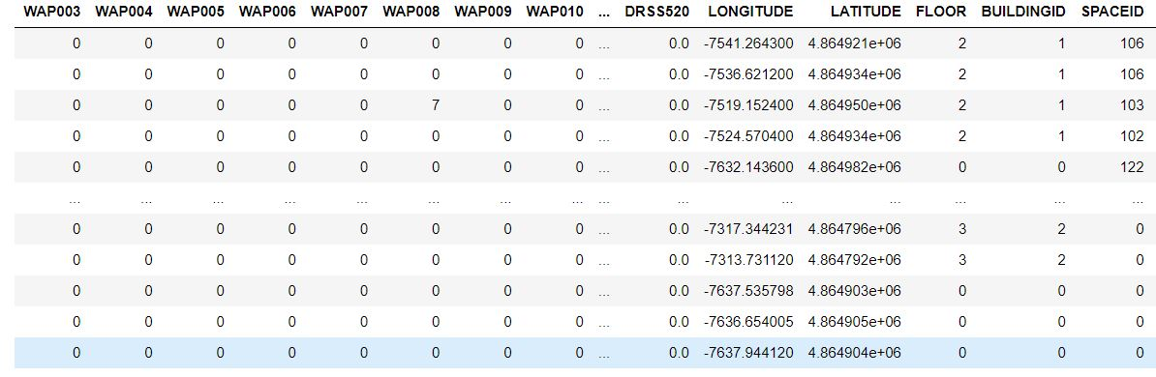
The modified dataset consists of 520 new columns of DRSS values for every receiving node (datapoint) along with the previous features.

Slide 31
Incorporating the new feature
We trained the same models as before ( KNNs, SVM, MLP Classifier) using the modified dataset to see the improvements.
We observed satisfying improvements in these models using our Feature Engineering Approach.
The accuracy score plots comparing the latter and the modified technique have been shown on the next slide.
We are now working upon using the GNN model to give a further boost to the accuracy score.

Slide 32
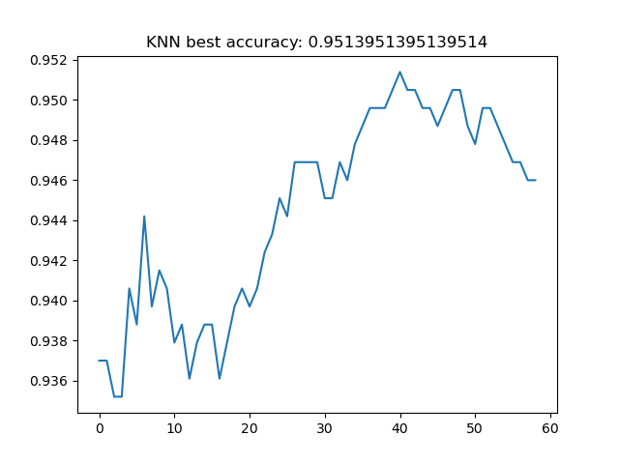
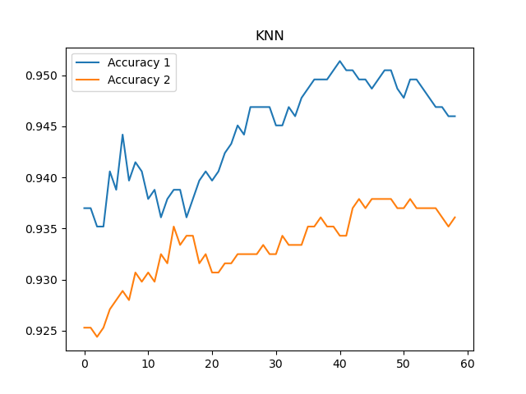
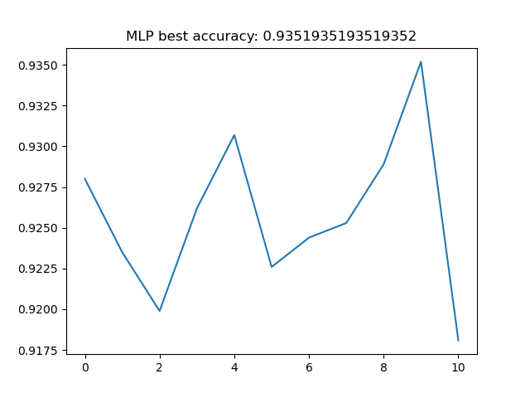
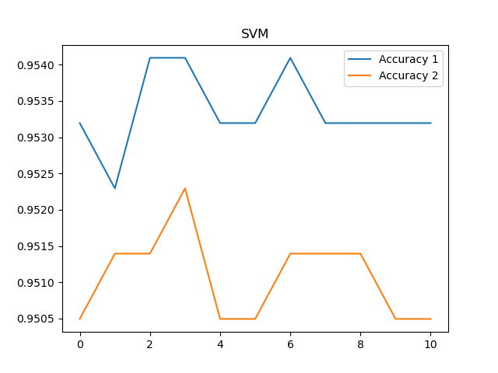
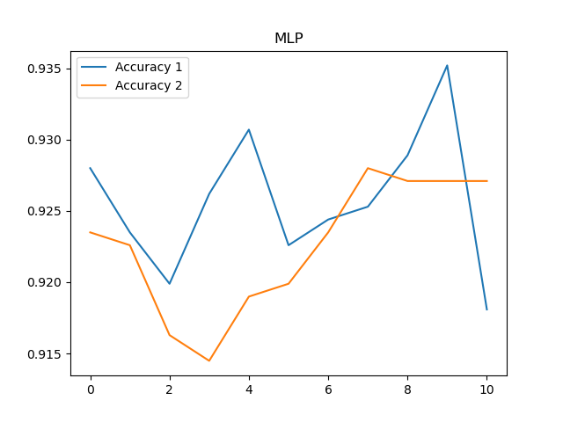
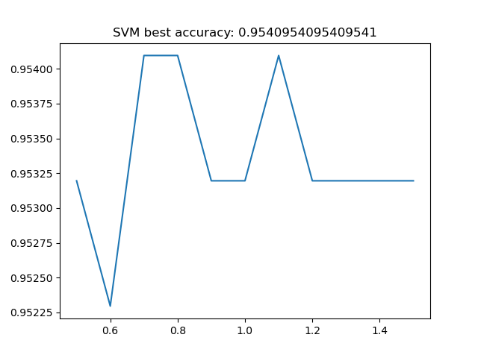

Slide 33
Towards a Graphical Approach
Converted the tabular data to graph structure using K Nearest Neighbours algorithm.
Fed this data to a GNN model consisting of convolutional, ReLU, and fully connected layers.
This takes into account the information from the neighbourhood of the nodes and their features also according to their importance.
The neighborhood of a node consists of its adjacent nodes in the graph. Graph Neural Networks (GNNs) aggregate information from the neighborhood of each node to capture local structural patterns.

Slide 34
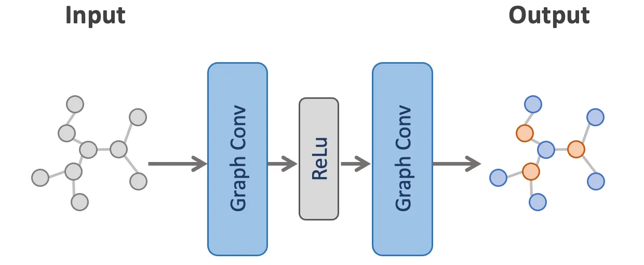
GCN Architecture

Slide 35
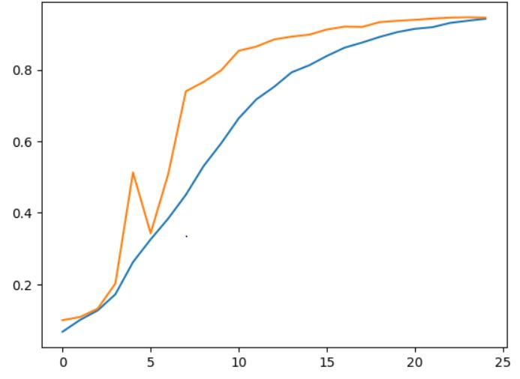

Slide 36
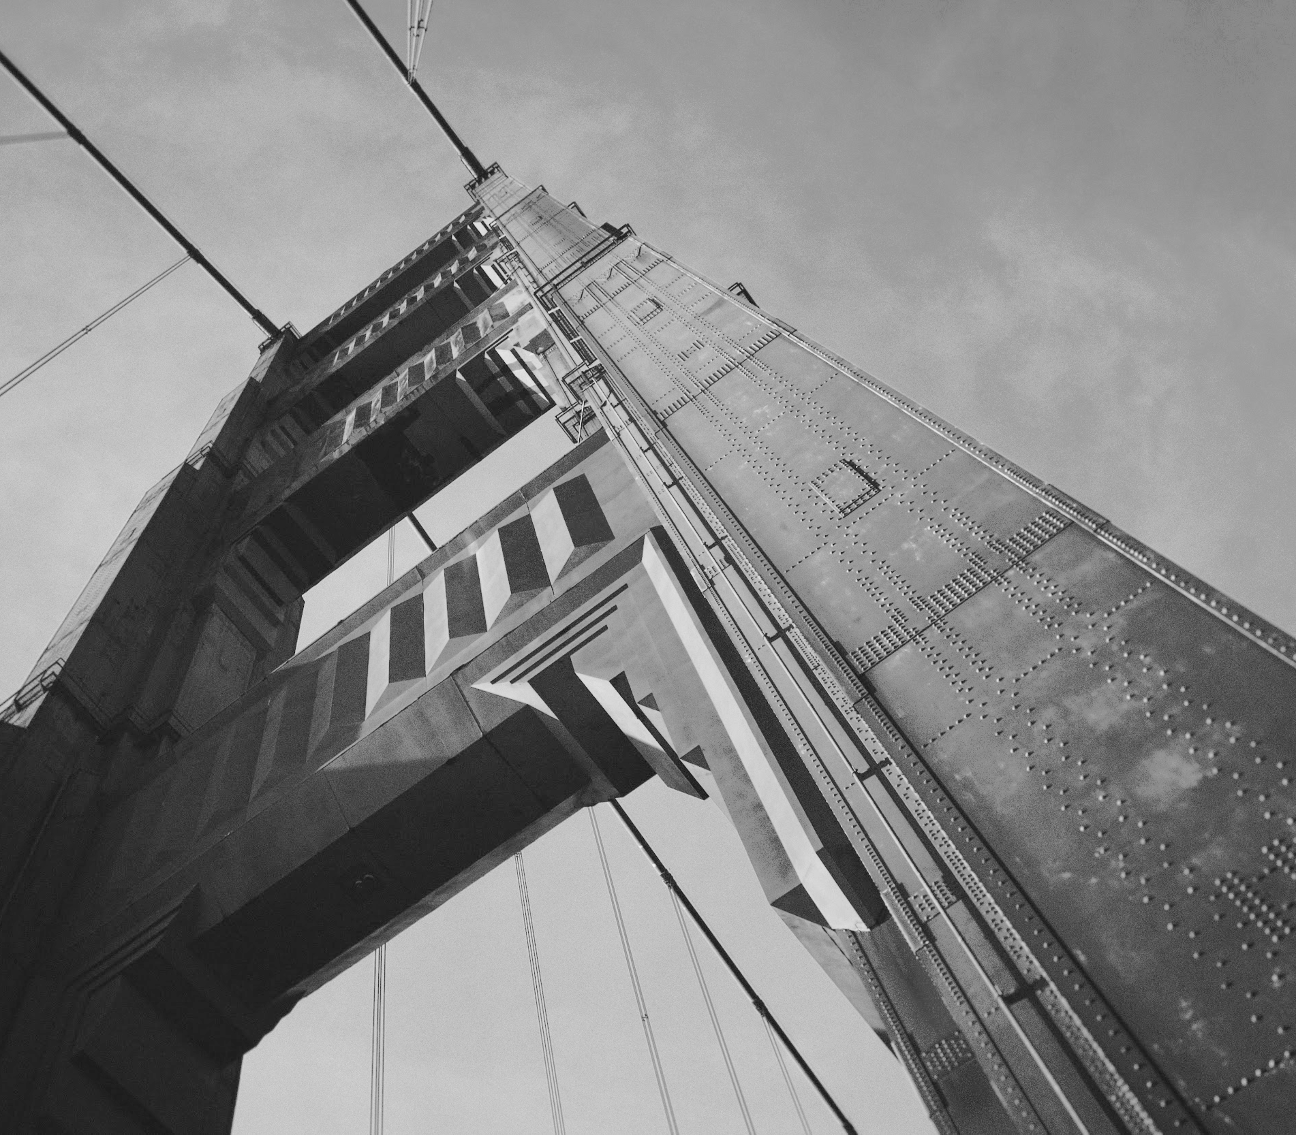
Thanks!
Contact us:
Porav Rohilla
210727
( poravr21@iitk.ac.in)
Umang Sinha
211124
( umangs21@iitk.ac.in)

